Slide 1
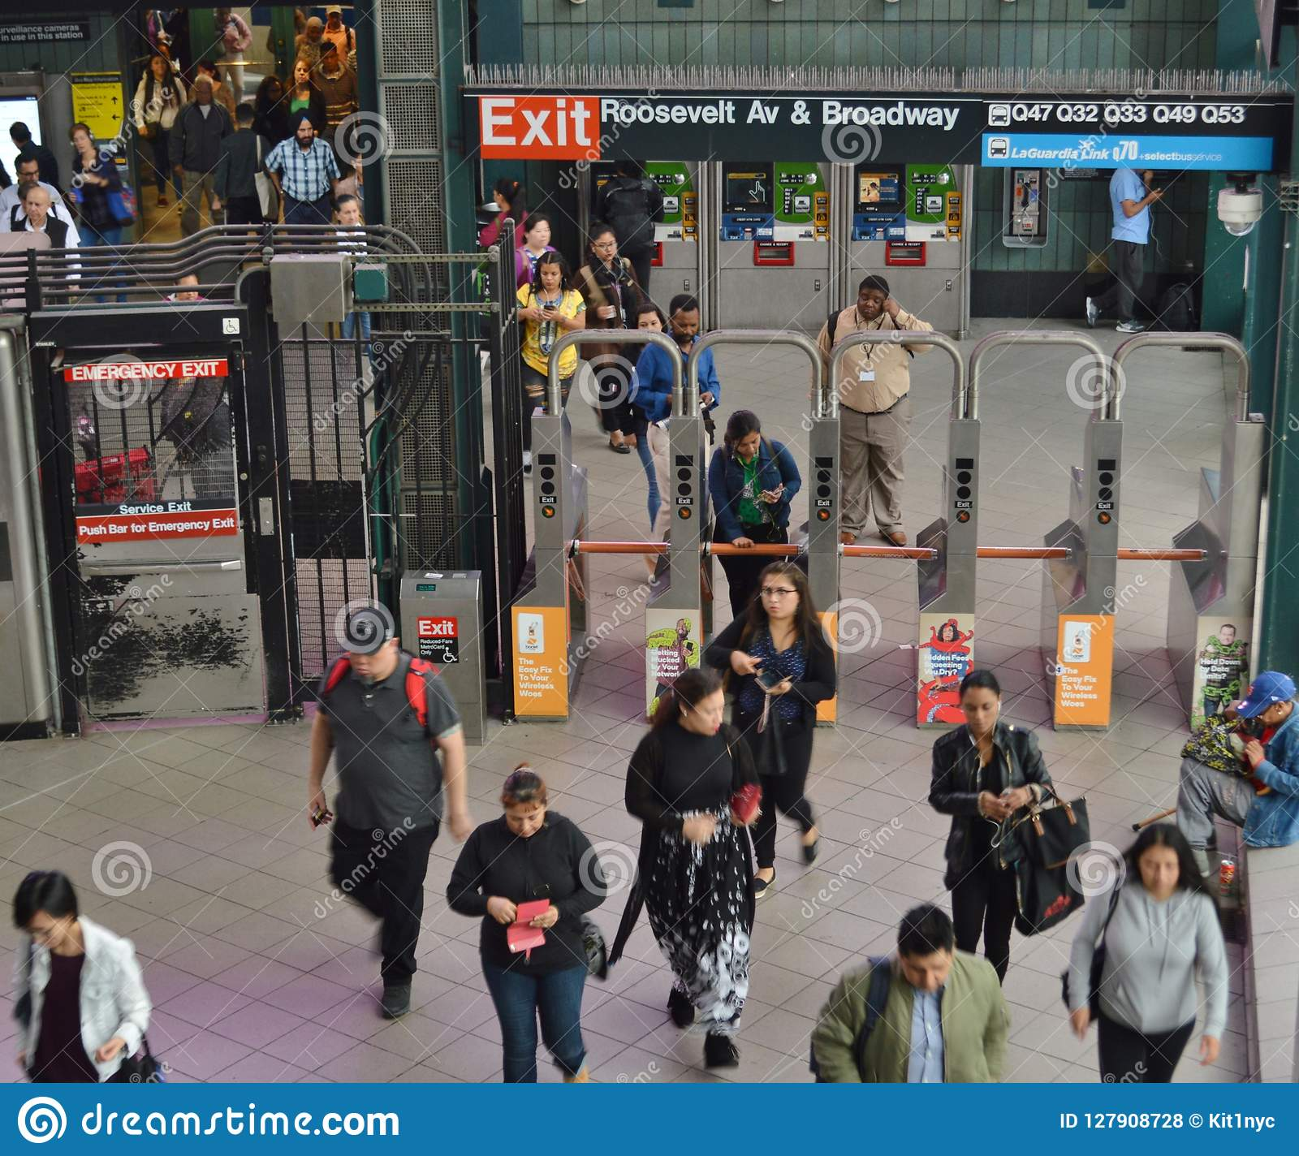

PROJECT 1 : Exploratory data analysıs (EDA)
- MTA TURNSTILE DATA -
Group 2 : Vildan TELLİOĞLU
Taha Yasin YILMAZ
Birsen BAŞ
Selva TAŞ

Slide 2

INTRODUCTION
SOLUTON
RECOMMENDATION
PROBLEM DEFINITION
OBJECTIVE
Using MTA Turnstile Data and NYPD Hate Crimes Data, to perform exploratory data analysis to find best placement for our police officers.
Finding the busiest metro station, the busiest day, the best date for placement police officers, and finding the rate of crime types with additional data
Raising awareness and giving information about crimes committed in the region during the police week.

Slide 3


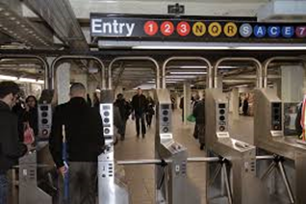







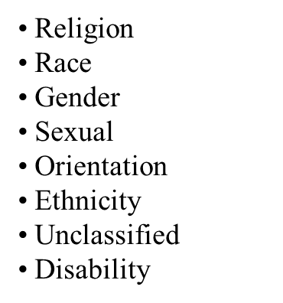
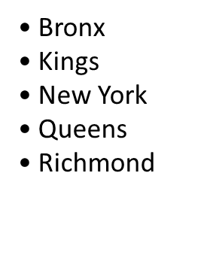





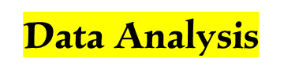

METHODOLOGY
MTA Turnstile Data
Working
Environment
• First two weeks of May 2018-2021
•2 weeks , 8 txt file included

Slide 4
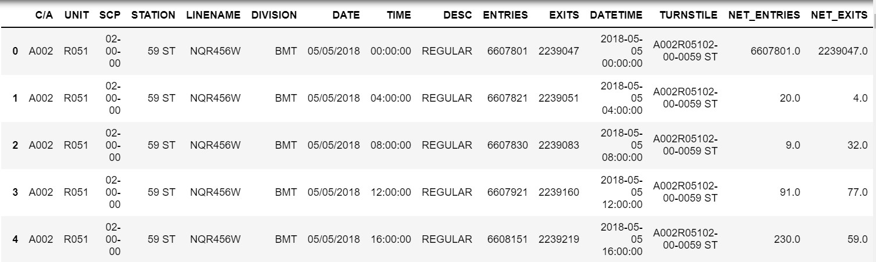
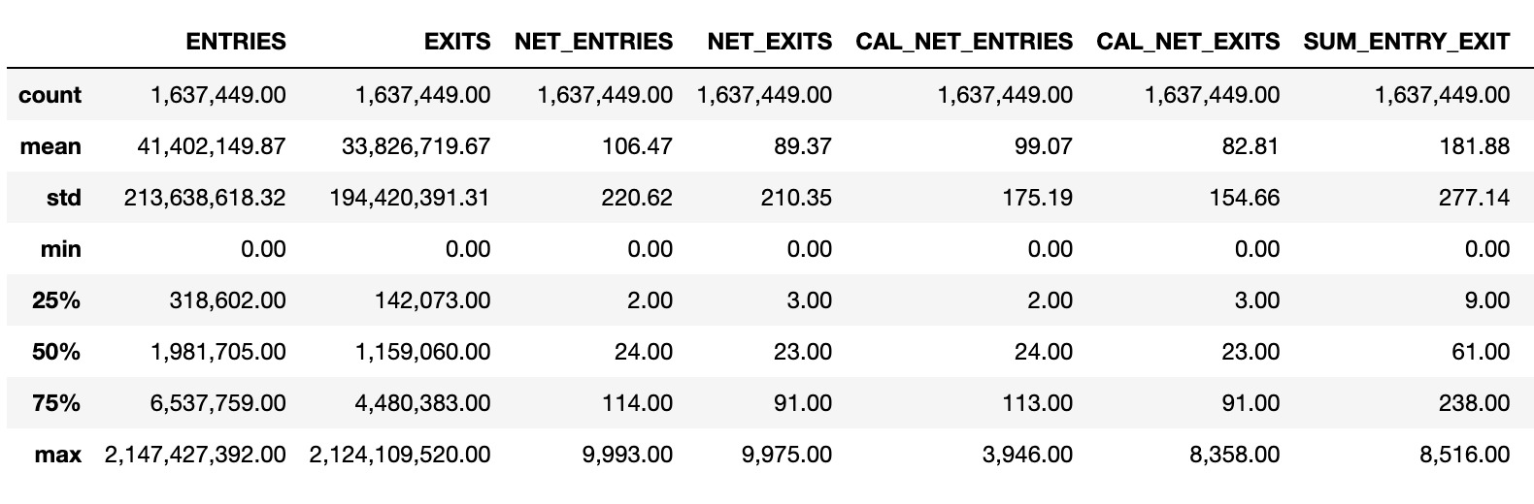
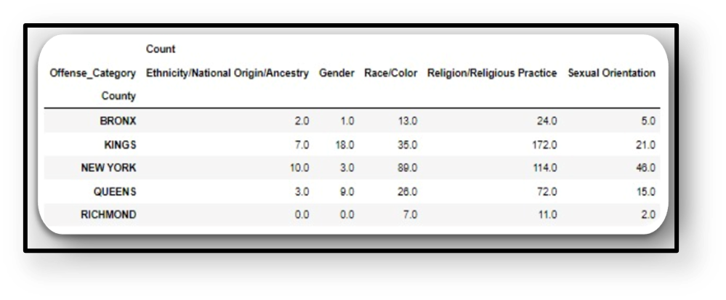
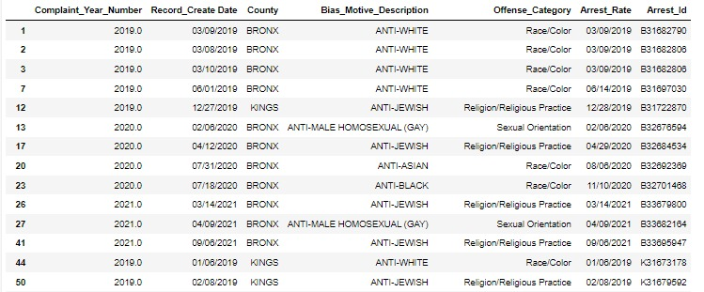
ABOUT DATA
MTA Turnstile Data
• Data row and column numbers were examined.
• Number of turnstiles was found.
Hate Crime Data

Slide 5
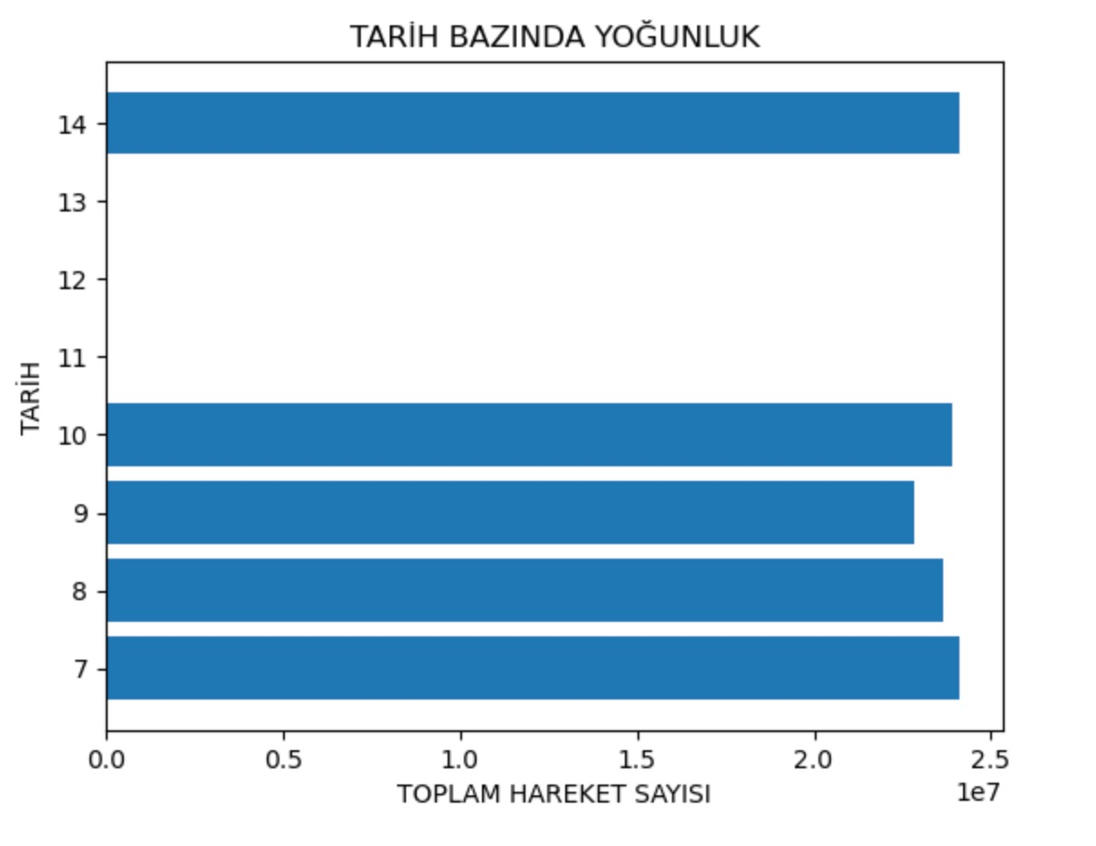
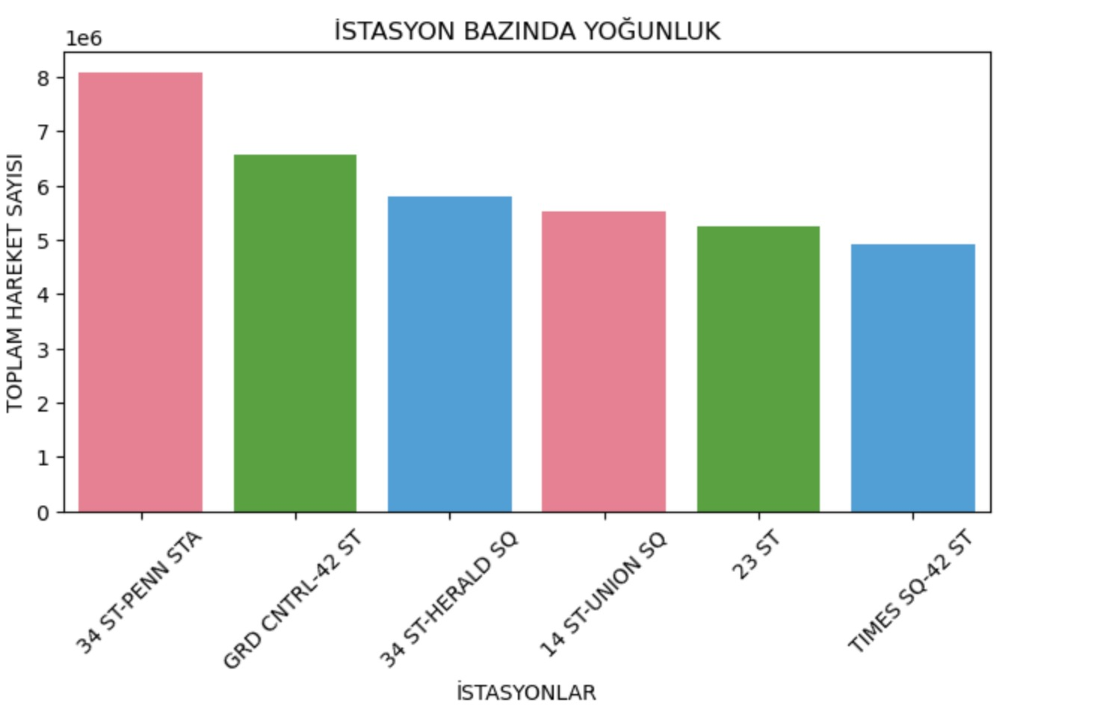
RESULTS
• Since Police Week is celebrated on the 15th of May, the busiest days in the first two weeks of May were determined.
• When the data of the first two weeks of May 2018-2021 are examined, the most frequently used stations are as in the image.

Slide 6

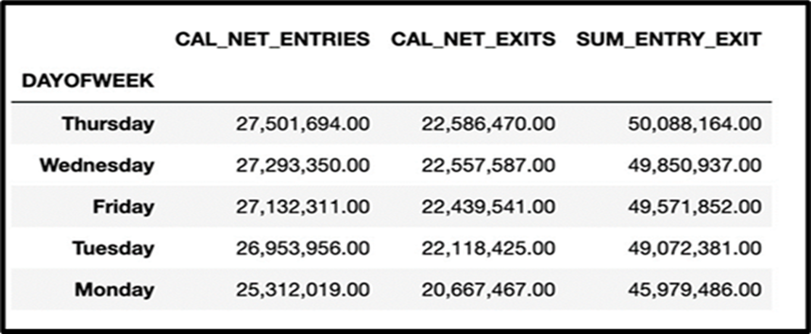

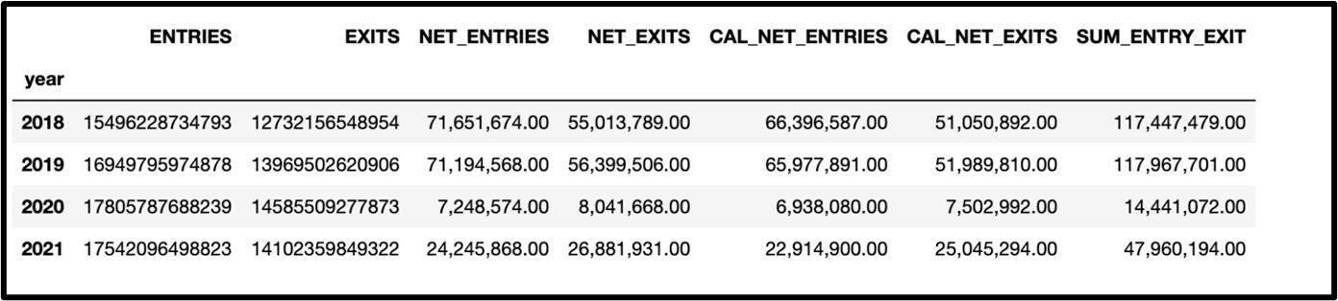

Slide 7
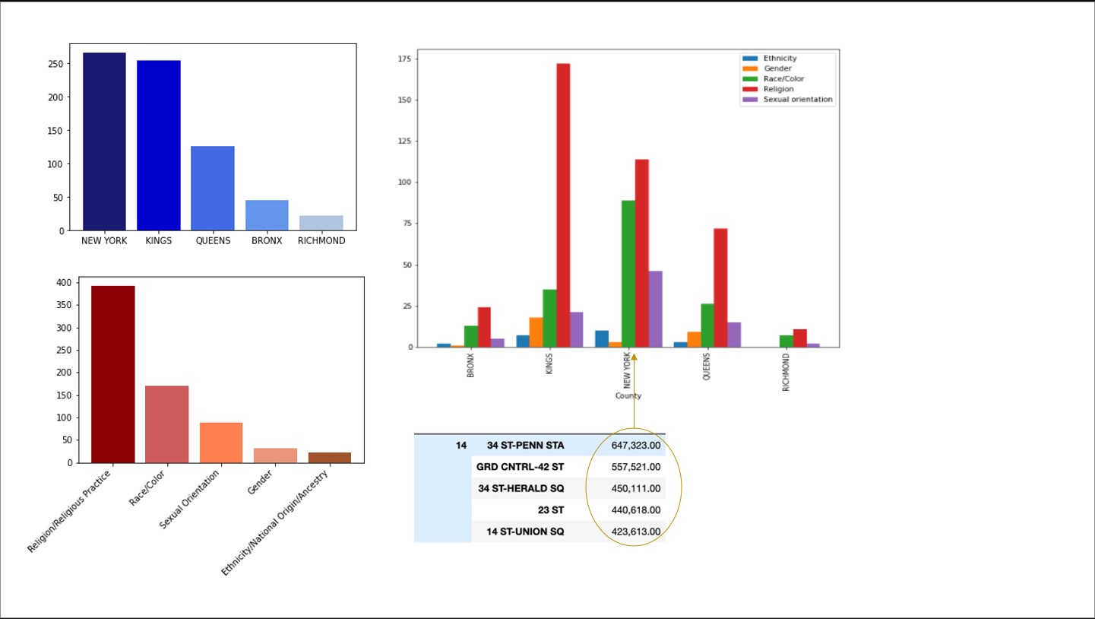
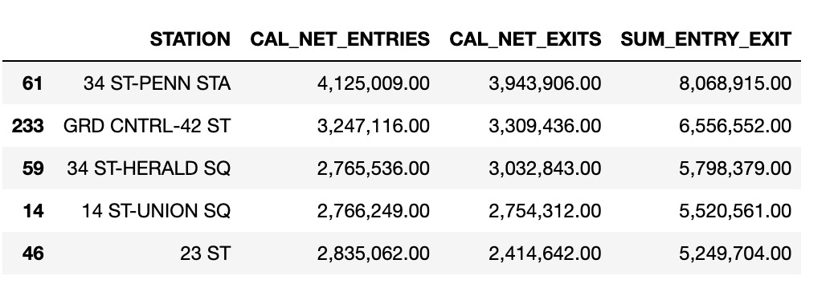
RESULTS
Crime rates in County ;
Crime Types Distribution for Borough
Crime Types Distrubision
Most used stations between 2018-2021.

Slide 8
CONCLUSIONS
01
We identified the most productive 5 days and 5 stations for the 10 cops to be assigned to the NYPD.
Day: 7, 8 , 9, 10 and 14 Stations: 34 ST-PENN STA GRD CNTRL-42 ST
34 ST-HERALD SQ
14 ST-UNION SQ
23 ST
02
According to the data analysis, the best option according to the crime types in Hate Crime data is shown in New York for placement police officers.
According to the crime types in Hate Crime data is shown the most crime is Religion/Religious Practice & Race Color.

Slide 9
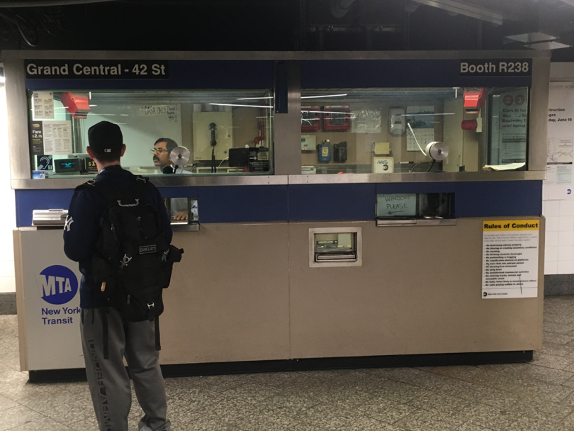

FUTURE WORK
What else we do, if we had more time ?
Finding and analyzing more additional data to reach better analysis results and visualization
.
Processing the data by examining it with statistical methods

Slide 10
Thank you so much for listening to us.

